Slide 1
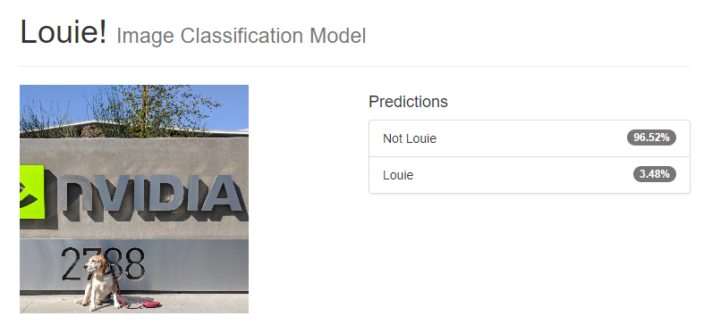
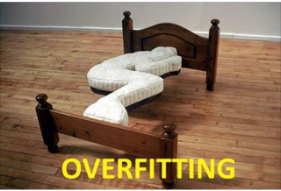
Overfitting
What to do about it?
Notes:
This slide represents the shortcoming of our toy dataset and highlights the need for big data.

Slide 2
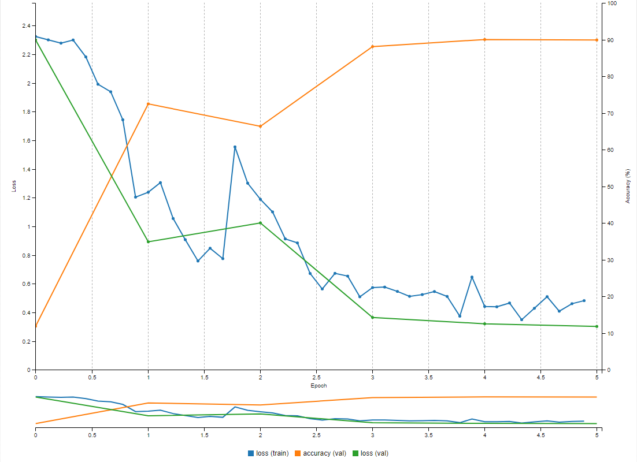
Next Page - EVALUATE THE MODEL
Accuracy
obtained from validation dataset
Loss function
(Training)
Loss function
(Validation)
Notes:
When you’ve seen the majority of the class has trained their first model and has a graph like above, interrupt to use the graph as a teaching tool.
The blue curve is the “loss” of the network on the data it is learning from. The process starts by presenting the first image to an untrained network. The network then generates an output that is likely very wrong, seemingly random. For example, if the first image was of an 8, the network may output that there’s a 15% likelihood it’s an 8, (and a random assortment of likelihood’s that it’s any other number), but since it’s labeled, we’re 100% sure it’s an 8. That “loss” or “error” is then passed back through the network to update the “weights” of each neuron. The second image is then fed through the network with the new updated “weights.” The weights follow the slope, or gradient, of the loss as it descends or decreases.
The green curve is the “loss” of the network on data that it is *not* learning from. By default, when you loaded your dataset, you set 25% of the 0s, 1s, 2s, etc aside to *validate” that your network is learning about the differences between ALL 0s, 1s, 2s, etc., not just the ones that it are used for training.
The orange curve measures how often the prediction made from the validation set is correct.
[FEEL FREE TO EXPAND HERE….THIS IS A GREAT PLACE FOR QUESTION GENERATION!]

Slide 3
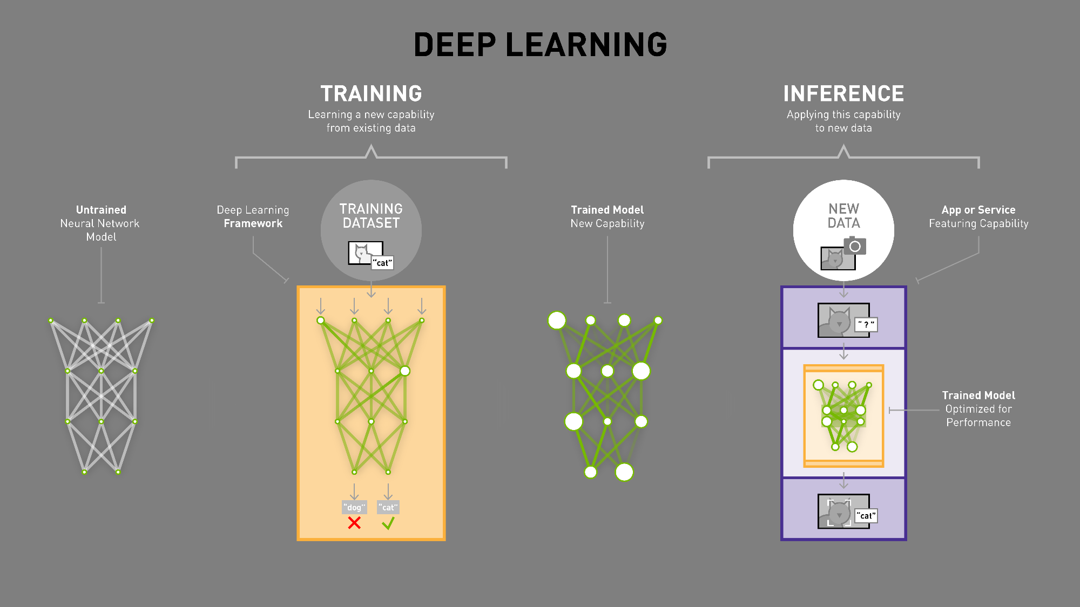
How it Works
Notes:
Let’s take a look at how deep learning actually works in practice…
Here you can see a very simple model of an untrained neural network. At the top of the model, there is a row or “layer” that has 4 input nodes, and at the bottom there is a layer that has 2 output nodes. Between the input layer and the output layer are a few “hidden” layers with several nodes each. The white lines show which nodes in the input layer share their results with nodes in the first hidden layer, and so on all the way down to the output layer. You may hear the nodes referred to as “perceptrons” or “artificial neurons” since their behavior is inspired by the neurons in the human brain.
A real deep neural network model would have many additional layers between the input layer and the output layer - which is why it’s called “deep” - but a simplified model will work fine for this example.
Just keep in mind that the design of the neural network model is what makes it suitable for a particular task. For example, the best models for image classification are very different from the best models for speech recognition. And the variations can include the number layers, the number of nodes in each layer, the algorithms performed in each node, and the connections between nodes.
So, if the goal is to train a deep neural network to distinguish cats vs. dogs, you would select a neural network model that is designed to be good at image classification.
[next]

Slide 4
How it Works
Notes:
The next step is to assemble a collection of representative examples to be used as a training dataset. In this case, several thousand images of both cats and dogs, each with a label indicating whether it belongs to the cat class or the dog class. To ensure the dataset is representative of all the pictures of dogs and cats that exist in the world, the dataset must include a wide range of species, poses, and environments in which dogs and cats may be observed.
Then a deep learning framework is used to feed the training dataset through the network. For each image that is processed through the network, each node in the output layer reports a number that indicates how confident it is that the image is a dog or a cat. In this case there are only two options, so the model only needs two nodes in the output layer – one for dogs and one for cats. When these final outputs are sorted most-confident to least-confident, the result is called a confidence vector. The deep learning framework then looks at the label for the image to determine whether the network chose the correct answer. If it chose correctly, the framework strengthens the weights of the connections that contributed to getting the correct answer. And vice-versa, if it chose incorrectly, the framework reduces the weights of the connections that contributed to getting the wrong answer.
After processing the entire training dataset once, the neural network will generally have enough experience to choose the correct answer a little more than half of the time (so better than a random coin toss) but it will require several additional rounds or “epochs” of processing the entire training dataset to achieve higher levels of accuracy.
It’s worth noting that there are readily available models for image classification, object recognition, image segmentation and several other tasks – but it is often necessary to modify these models to achieve high levels of accuracy for a particular dataset. So the computation required to train one version of the model is multiplied by the number of model variations that need to be evaluated. All of this processing requires a tremendous amount of computation, much of which can be performed in parallel, which makes deep learning an ideal workload for GPUs to accelerate.
There are also many deep learning frameworks to choose from, each with its own set of strengths, programming language interfaces, etc. but they’re all GPU-accelerated using cuDNN and other libraries in the NVIDIA Deep Learning SDK. You can learn more about all the deep learning frameworks and the NVIDIA Deep Learning SDK on our developer web site at developer.nvidia.com.
[next]

Slide 5
How it Works
Notes:
So, now that the model has been trained on a large representative dataset, it’s very good at distinguishing between cats vs. dogs. But if you showed it a picture of a racoon it would be very confused since it has no experience with racoons, and would probably report a low confidence number for both dog and cat.
If you need the ability to classify racoons as well as dogs and cats, you would simply add a third node to the output layer of the model, expand the training dataset to include thousands of representative images of racoons, and use the deep learning framework to re-train the network.
There’s no need to manually write a racoon classifier algorithm and figure out how to integrate it into your application, just re-train the deep neural network with your new data set.

Slide 6
How it Works
Notes:
Once the model has been trained, much of the generalized flexibility that was necessary during the training process is no longer needed, so it’s possible to optimize the model for significantly faster runtime performance.
[Story: How Cooper learned to classify cars, “tucks”, busses, motorcycles, etc.]
Common optimizations include fusing layers to reduce memory and communication overhead, pruning nodes that do not contribute significantly to the results, and other techniques supported in the NVIDIA TensorRT runtime.
The fully trained and optimized model is then ready to be integrated into an application that will feed it new data, in this case images of dogs and cats that it hasn’t seen before, and it will be able to quickly and accurately infer the correct answer based on its training. And your application can be deployed on a GPU-accelerated platform in your datacenter, in the cloud, on a local workstation, in a robot, a smart camera, or even a self-driving car.

